Slide 1
Dashboard for business stakeholders.
created by
:
Musham Praveen Kumar
Date
:
25-04-2025

Slide 2
Objective
Design an interactive dashboard for business stakeholders using Power BI or Tableau, showcasing key KPIs (Sales, Profit, Growth) with enhanced interactivity, time-series analysis, and a user-friendly navigation menu.

Slide 3
Data Set Summary
Source:
Kaggle Dataset(Sales_Analysis_Train .csv)
key columns :
-Order Date
-State
-Sales
-City
-Profit
-Region
-Product Name
-Country

Slide 4
Dashboard Overview
The Dashboard Includes:
-KPI Cards (Sales, Profit )
-Bar Graphs
-Top 10 Sub Catergories
-Total Sales
-Total Profit
-Sales over Tim

Slide 5

Total sales
$2,500,000.00
$2,261,536.78
$2,000,000.00
Sales
$1,500,000.00
$1,000,000.00
$500,000.00
$0.00

Slide 6

total proﬁt
Country
4,922
2000K
1500K
Sales
1000K
500K
0K
United States

Slide 7
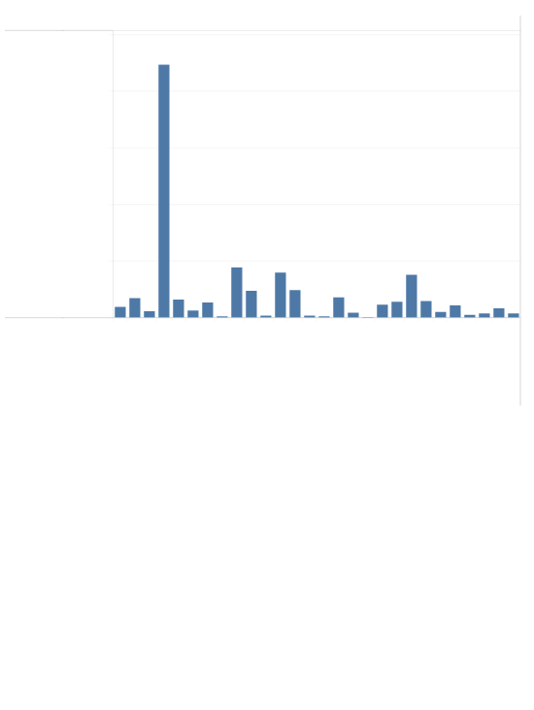
Country
500K
State
570
400K
300K
United States
Sales
200K
Louisiana
20
Maine 3
100K
231
Maryland Massachusetts
45
Connecticut
43
Indiana
67
Michigan Minnesota Mississippi Missouri
62
42
105
Alabama
34
Delaware
43
Iowa 16
0K
District of Columbia 4
Idaho 11
Kansas 14
25
Arizona Arkansas
99
Kentucky
56
Colorado
74
Illinois
California
Florida Georgia
80
178
Montana 8
Nebraska 23
23
Nevada
New Hampshire 17

Slide 8
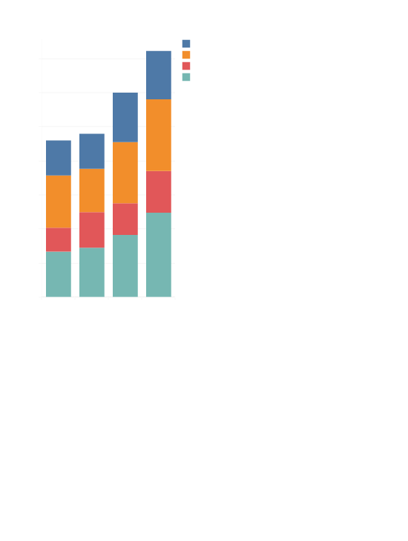
sales over time
Order Date
Region
Central East South West
700K
600K
500K
Sales
400K
300K
200K
100K
0K
2016
2015
2017
2018

Slide 9

Sales by region
Region
West East Central South
0K
50K
100K
150K
200K
250K
300K
350K
400K
450K
500K
550K
600K
650K
700K
Sales

Slide 10
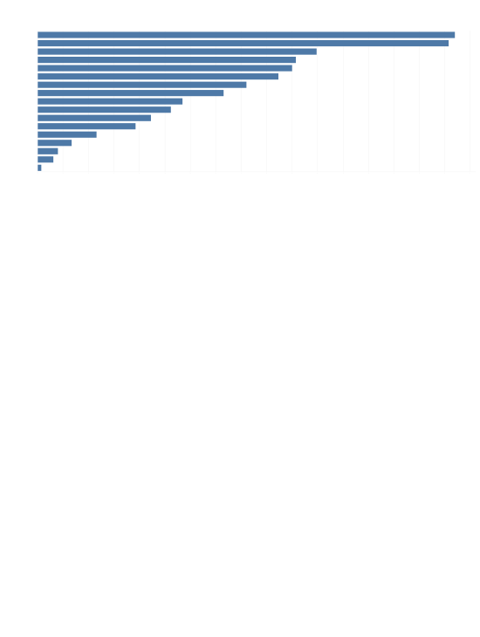
Tp 10 sub categories
Sub-Catego..
Phones Chairs Storage Tables Binders Machines Accessories Copiers Bookcases Appliances Furnishings Paper Supplies Art Envelopes Labels Fasteners
0K
20K
40K
60K
80K
100K
120K
140K
160K
180K
200K
220K
240K
260K
280K
300K
320K
340K
Sales

Slide 11

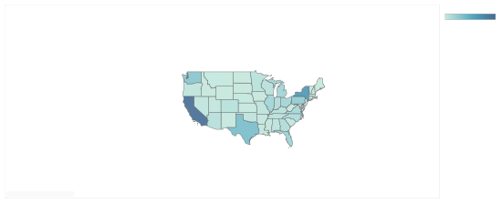
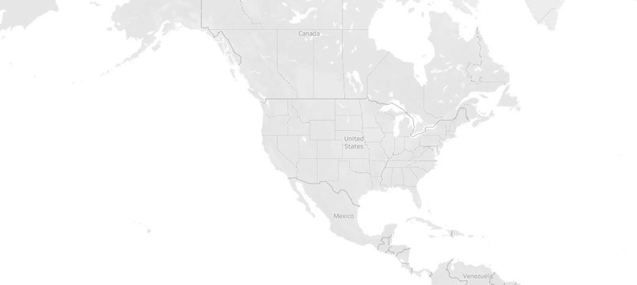
Sales by state
Sales
920
446,306
© 2025 Mapbox © OpenStreetMap

Slide 12
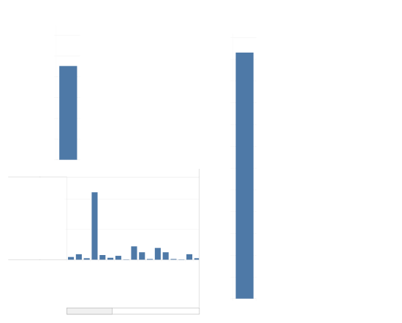
Total sales
total proﬁt
$3,000,000.00
2400K
Country
$2,500,000.00
$2,261,536.78
2200K
4,922
$2,000,000.00
2000K
Sales
$1,500,000.00
1800K
$1,000,000.00
1600K
$500,000.00
1400K
$0.00
Country
State
Sales
1200K
570
1000K
400K
800K
United States
Sales
200K
600K
Alabama 34
99
Connecticut
43
Indiana
400K
0K
Illinois
Iowa 16
Delaware
Idaho 11
231
Arizona
43
Kentucky
Colorado
Kansas 14
Arkansas 27
74
District of Columbia 4
Louisiana
200K
California
Florida Georgia
178
0K
United States

Slide 13
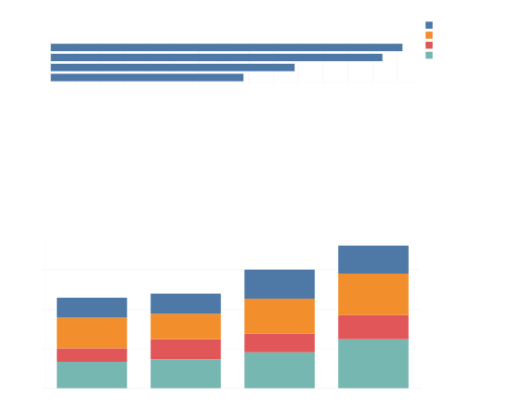
Sales by region
Region
Central East South West
Region
West East Central South
0K
50K
100K
150K
200K
250K
300K
350K
400K
450K
500K
550K
600K
650K
700K
Sales
sales over time
Order Date
600K
Sales
400K
200K
0K
2016
2015
2017
2018

Slide 14
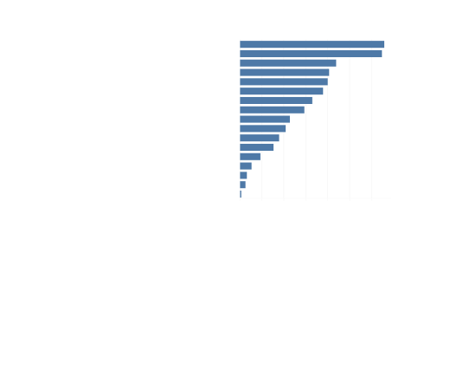
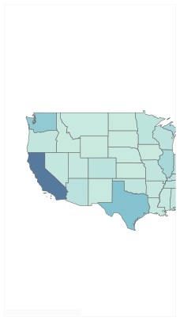
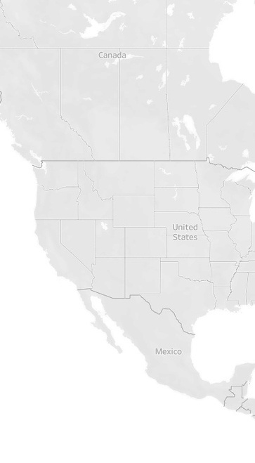
Sales by state
Tp 10 sub categories
Sub-Category
Sub-Catego..
Phones Chairs Storage Tables Binders Machines Accessories Copiers Bookcases Appliances Furnishings Paper Supplies Art Envelopes Labels Fasteners
Accessories Appliances Art Binders Bookcases Chairs Copiers Envelopes Fasteners Furnishings Labels Machines Paper Phones Storage Supplies Tables
0K
50K
100K
150K
200K
250K
300K
Sales
Sales
920
446,306
© 2025 Mapbox © OpenStreetMap

